Slide 1
Presentation on interNship work on PythoN and Machine learning
Presented by:
G.Sai Teja
VII Semester
Dept. of ECE, SITE

Slide 2
Table of Contents
College Name
Company Profile
Topics covered in Internship
Introduction to Domain(Machine Learning)
Types of Machine Learning
Projects Done
Methodology and Explanation
Skills adopted during Internship
Conclusion

Slide 3
Sasi Institute of Technology & Engineering,Tadepalligudem

Slide 4
COMPANY INTRODUCTION
Company Name: Karunadu Technologies Private Limited.
Location: Bangalore, Karnataka, India.
Company Main Objective: To Empower Unskilled Individual with knowledge, skills and technical competencies in the field of Information Technology and Embedded engineering which assist them to escalate as integrated individuals contributing to company’s and Nation’s growth.
Internship Duration: Sep-Oct 2021 (6-weeks).
Internship Mentor: Sunil S.
Domains:Python With Machine Learning.
Machine Learning Platforms: Jupyter Notebook.

Slide 5
Topics Covered In Internship
Basics of Python
Introduction and implementation of numpy, matplotlib, open cv library
Image Processing: Face detection and eye detection in an image using haarcascades
Working with video file, Face and eye detection in a video file
Introduction of PyQt5, creating window application using PyQt5
Introduction to Machine Learning domain and its types
Application of Linear Regression and Multilinear Regression algorithms
Application of Logistic Regression and KNN algorithms
Application of Decision Tree and SVM algorithms

Slide 6
Basics of Python
Introduction
Keywords and variables
Libraries and statements
Datatypes and Operators
Loop Statements
Functions
Lamba Functions
Modules
Packages
Files

Slide 7
Definition of matplotlib
What is Matplotlib Pyplot in Python?
matplotlib. pyplot is a collection of functions that make matplotlib work like MATLAB. Each pyplot function makes some change to a figure: e.g., creates a figure, creates a plotting area in a figure, plots some lines in a plotting area, decorates the plot with labels, etc. In matplotlib.

Slide 8
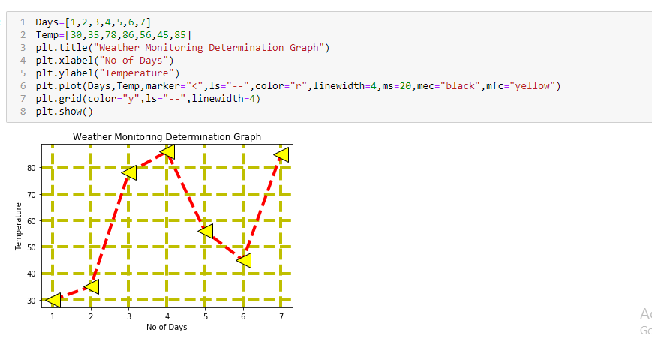
weather Monitoring using Matplotlib

Slide 9
program for live streaming using opencv
#live video stream
import cv2 #read the video
path="C:\\Users\\VAIO\\Desktop\\PYQT5\\opencv\\Images\\carsvideo.mp4"
capture=cv2.VideoCapture(0) #10 sec
while capture.isOpened():
ret,frame= capture.read()# rect-1 is the video is read successfully o-if video is not reading
#video frame by frame
if ret==0:
break;
cv2.imshow('Video read',frame)
if cv2.waitKey(1)==ord('q'):
break
capture.release()
cv2.destroyAllWindows()

Slide 10
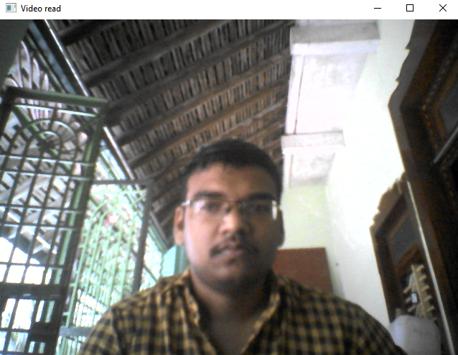
Video Streaming using opencv

Slide 11
Application on linear regression
import pandas as pd
import matplotlib.pyplot as plt #used for plotting the graphs
import sklearn #machine learning librar
from sklearn import linear_model #importing only linear model
dir(pd)
path="C:\\Users\\VAIO\\Desktop\\PYQT5\\ML\\homeprices.csv" #path of the file
data = pd.read_csv(path)#read_csv function is used ---Used to read the file
print(data)
inputs=data.drop('price','columns')
print(inputs)
output=data.drop('area','columns')
print(output)
plt.scatter(inputs,output) #plotting the graph
model = linear_model.LinearRegression()# intialize the model
model.fit(inputs,output)#training the model
result= model.predict([[4600]]) #predicing the value of the price for given area
print(result)
acc=model.score(inputs,output)
print(acc*100)
print(model.intercept_)
print(model.coef_)

Slide 12
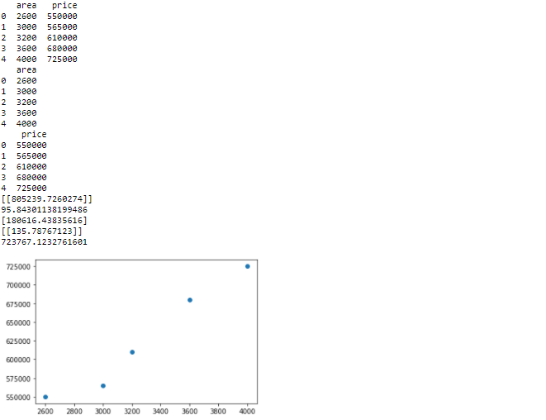
OUTPut of linear Regression

Slide 13
Introduction to Machine Learning
Machine Learning is a field of Computer Science that makes computers to learn from experience like human beings or animals.
ML algorithms make data-driven predictions or decisions by building mathematical models from empirical data.
There are three type of Machine Learning algorithms
i) Supervised Learning
ii) Unsupervised Learning
iii) Reinforcement Learning

Slide 14
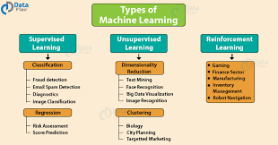

Slide 15
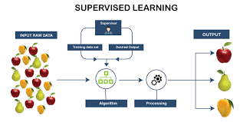
Supervised Learning

Slide 16
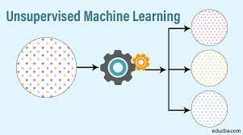
Unsupervised Learning

Slide 17
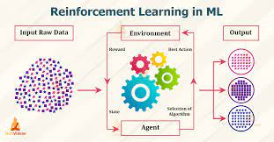
Reinforcement Learning

Slide 18
Projects To Be Implemented:
Prediction of Exam marks in Mark Prediction dataset using Multiple Linear Regression Algorithm

Slide 19
Multiple Linear REgression
What do you mean by multiple regression?
Multiple regression is a statistical tool used to derive the value of a criterion from several other independent, or predictor, variables. It is the simultaneous combination of multiple factors to assess how and to what extent they affect a certain outcome.as.
For example, if you're doing a multiple regression to try to predict blood pressure (the dependent variable) from independent variables such as height, weight, age, and hours of exercise per week, you'd also want to include sex as one of your independent variables.

Slide 20
Exam Marks Prediction
Objectives : To Predict Exam Marks using Multiple linear Regression
Software used: Anaconda, Jupyter notebook
Algorithm used: Multiple linear Regression
How to:
i. Read the csv file using pandas opencv() function.
ii. Apply Data preprocessing technique to clean the data.
iii. Divide data set into x and y; x having independents value and y having dependents variables.
iv. Further dividing x and y into x_test, x_train and y_test, y_train respectively using train_test_split().
v. Importing and applying Multiple linear Regression model as from sklearn import linear_model

Slide 21
code For Exam Marks prediction:
import pandas as pd
import sklearn
from sklearn import linear_model
path ="C:\\Users\\VAIO\\Desktop\\PYQT5\\new datasets\\12_ExamMarkPrediction_LINEARREGRESSION_MULTIPLEVARIABLES\\data.csv"
data = pd.read_csv(path)
print(data)
data.hours = data.hours.fillna(data.hours.median())
print(data)
inputs = data.drop('marks','columns')
output = data.drop(['hours','age','internet'],'columns')
print(inputs)
print(output)
model = linear_model.LinearRegression() #initializing the model
model.fit(inputs,output) #trained
print(model.predict([[6.8,15,1]]))
model.score(inputs,output) #accuracy
print(model.intercept_)
print(model.coef_)

Slide 22
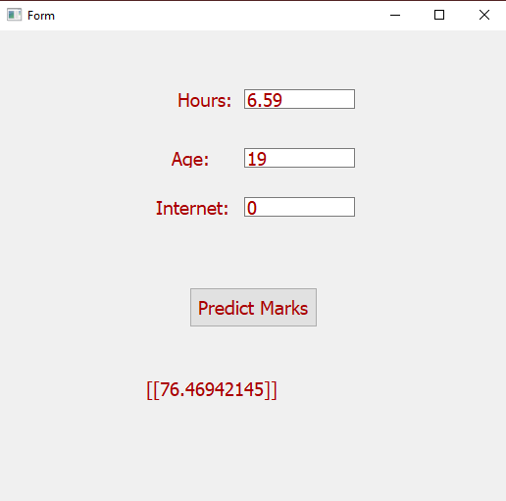
output-1:

Slide 23
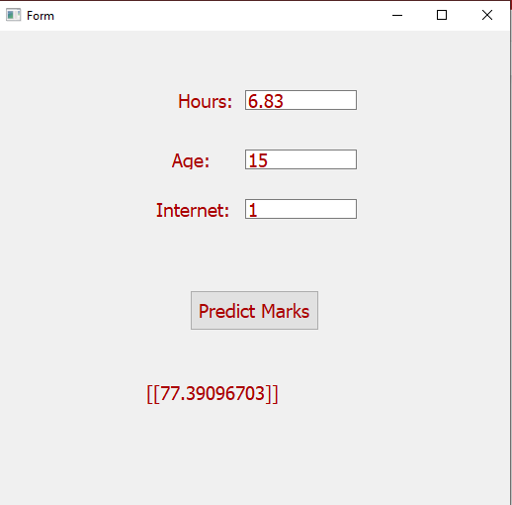
output-2:

Slide 24
Conclusion
The company gave a broad spectrum of knowledge in the domain of Machine Learning which required us to learn more about the machine learning.
Work on different cross-platforms and different Python libraries which done my Python Programming skills and Data Analyst skills.
Helped to acquire knowledge about work-culture of Corporate IT sector in India.

